Slide 1

Assistive technology for improving reading literacy
Julia Frey (4721771), Modulprüfung Modul 1, Prof. Dr. Bianca Roters
(Digital) Literacy Safari: Fostering Reading in EFL learning settings

Slide 2

Structure
Introduction
  Background and Relevancy
  Research Question
Characterization of SEN students
Development of Reading Literacy
  Cognitive and Lingual processes
  Special Challenges
Reading in a Foreign Language
Phonemic Awareness
Assistive Technology
  Definition and History
  Reading Pens
Prior Research
  Usage in EFL and SEN setting
  Effectiveness in studies
Teaching example
  Application of the unit
  Reactions
Pros and Cons
Conclusion
Sources
Appendix

Slide 3
1. Introduction
1.1 Background and Relevancy
“universelle[], uneingeschränkte[] Rechte auf Gleichstellung, Selbstbestimmung und gesellschaftliche Teilhabe von Menschen mit Behinderung” (UN-BRK in Rossa, 2015, p.169)
students should experience English as a foreign language and have cultural knowledge (Ministerium für Kultus, Jugend und Sport Baden-Württemberg, 2022)

Slide 4
1. Introduction
How can assistive technologies benefit students with special educational needs in improving their reading literacy in a foreign language?
1.2 Research Question

Slide 5
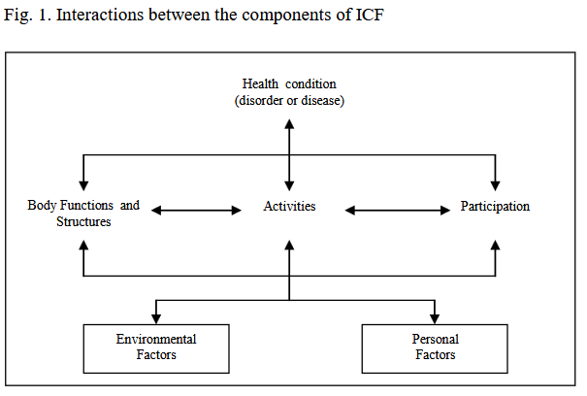
2. Characterization of SEN students
ICF describes general definition of disability: different aspects of life interact with each other →if one component is limited, others are also affected (World Health Organization, 2001)
persons who require additional support because of “disadvantages in physical, behavioural, intellectual, emotional and social capacities” (UNESCO Institute for Statistics)
includes “children with emotional, behavioral, or cognitive impairments or with intellectual, hearing, vision, speech, or learning disabilities; gifted children with advanced academic abilities; and children with orthopedic or neurological impairments” (The Editors of Encyclopaedia Britannica, 2025)
Some sources differentiate between learning disabilities and intellectual disabilities
Image 1

Slide 6
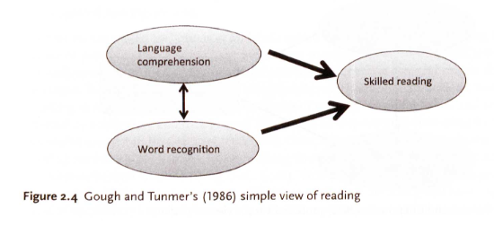
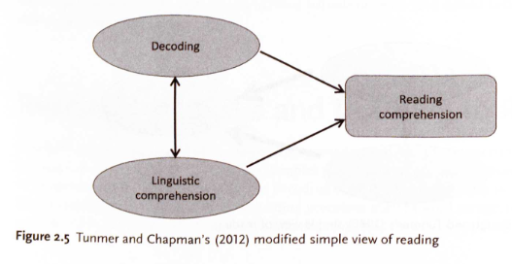
3. Development of Reading Literacy
(Kormos & Smith, 2024)
3.1 Cognitive and Lingual Processes
Reading is a complex skill with many processes that must work at the same time
Reading skills are in a hierarchy →low-level reading processes first
Gough and Tunmer’s “simple view of reading” (1986): language comprehension and word recognition lead to skilled reading
“Modified simple view of reading” (2012): decoding and comprehension are related
More complex models have been constructed
Image 2
Image 3

Slide 7
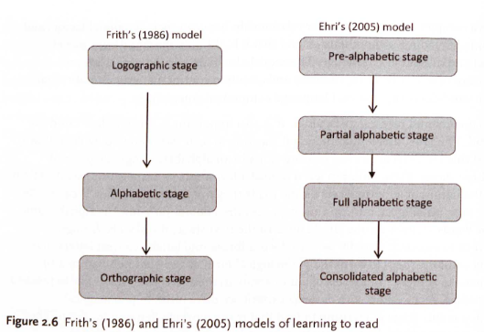
3. Development of Reading Literacy
(Kormos & Smith, 2024)
3.1 Cognitive and Lingual Processes
Most influential theory by Frith (1986) describes 3 stages of learning to read
Revised theory by Ehri (2005) describes 4 stages
Francis et al. (2018) combine these theories with human development through life stages →makes reading process easier
Image 4

Slide 8
3. Development of Reading Literacy
3.2 Special Challenges
Reading is a very important skill, also for SEN students
Word decoding is dependent on cognitive skills →might be impaired (Ruxandra, 2022)
Language aptitude as important factor →learners with disabilities might have underlying literacy difficulties or a weak short-term memory capacity
→poses additional burden on system

Slide 9
4. Reading in a Foreign Language
L1 reading skills as a foundation for L2 reading development → positive and negative interference (Biebricher, 2012)
More complex, “problems in letter recognition, [and] insufficient knowledge of morphology and syntax” (Kormos & Smith, 2024, p.58f)
Motivational and cognitive factors influence the ability to read in EFL
Different reading strategies can be applied: bottom-up and top-down processes
→SEN students might have impaired phonological processing skills

Slide 10
5. Phonemic Awareness
Phonological awareness: group of early skills that help children recognize sounds of spoken language (Reading Rockets, n.d.) →4 levels
Phonemic awareness as the “ability to focus on, distinguish, separate, and manipulate phonemes within pronunciations of words” (Ehri, 2022, p. 53)
Different exercises for improving phonemic awareness: manipulating sounds, recognizing same sounds, isolating sounds, combining & blending sounds, segmenting words
  Word level
  Syllable level
  Onset and rime level
  Phonemic awareness

Slide 11
6. Assistive Technology
6.1 Definition and History
“Any item, piece of equipment, or product system, whether acquired commercially, modified, or customized, that is used to increase, maintain, or improve functional capabilities of individuals with disabilities.” (McDaniel, 2021)
Long history, starting in early 1800s, acceleration in 20th century up to today (Hoel, 2021)
Different types of assistive technology are available: screen readers, magnifiers, speech input, alternative inputs (McDaniel, 2021)
Many different tools are used in classrooms today: text-to-speech tools, assistive listening systems, sip-and-puff systems, math tools, reading pens (Neese, n.d.)

Slide 12
6. Assistive technology
6.2 Reading Pens
Scanning pens
→Wizcom, Iris
Recording pens
→Livescribe, AnyBookReader
Work with publisher’s media
→tiptoi, TING
Work with own sound files
→AnyBookReader, Tellimero
Work with both
→BOOKii
(theReadingWell, n.d.)
(Glaser, 2022)

Slide 13
6. Assistive technology
6.2 Reading Pens
Wizcom: https://www.youtube.com/watch?v=_f400NcyxtM
LiveScribe: https://www.youtube.com/watch?v=p-x75LLT8sE
tiptoi: https://www.youtube.com/watch?v=LTy0AeiJR1k
AnyBookReader: https://www.youtube.com/watch?v=rl2SR5pVHwM
BOOKii: https://www.youtube.com/watch?v=i2vAAzspEzY
→advertisements or reviews, so there is a lot of explaining involved, not just using the pen

Slide 14
7. Prior Research
7.1 Usage in EFL and SEN setting
Learners with SEN might need special arrangements/accommodations →used on on-going-basis (Cambridge Assessment International Education, 2017)
Assistive technology can support students who experience difficulties with writing, reading and more through “through the use of specialized learning materials, specialized curricular software, communication programs and much more.” (Ruxandra, 2022, p.43)

Slide 15
7. Prior Research
7.2 Effectiveness in studies
Ruxandra, 2022
Nordström et al., 2019
Higgins & Raskind, 2005
Significant differences, especially in letter name knowledge, initial sound identification and familiar word reading in children with disabilities
Positive effects for development of reading literacy in children with disabilities
Positive effects on motivation and pen was used for furthering phonemic awareness by children with disabilities

Slide 16
8. Teaching Example
Text for lesson topic: Wendy and Wyatt try writing a funny spell (Chapter 1) (can be found in appendix)
3 students, 10-12 years old, all can read in German, but can not/barely read English words
Goal: students start being aware of specific phonemes that are different in English, can recognize them in written words →phoneme: /w/, like in ‘witch’ or ‘Wyatt’

Slide 17
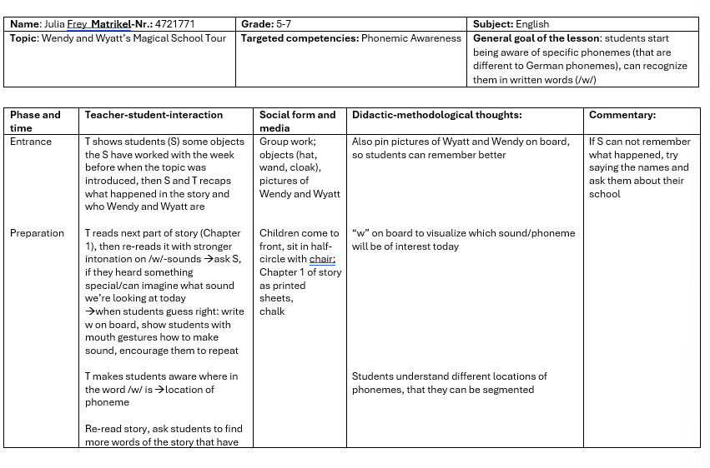
8. Teaching Example

Slide 18
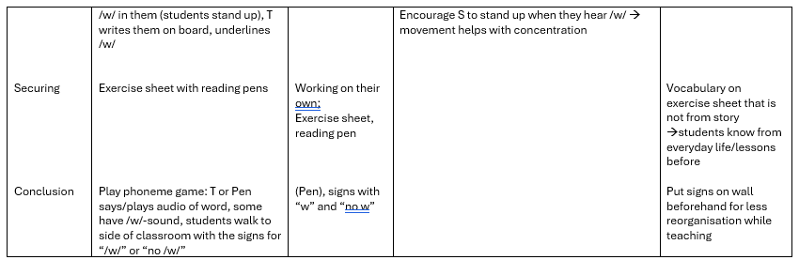
8. Teaching Example

Slide 19
8. Teaching Example
8.1 Application of the unit
Application: students were very interested and liked working with the pen, had mostly used it for comprehension exercises before, not phonemic awareness
Results:
  students were able to answer exercise sheet with only few mistakes, understood the /w/-sound, 2 of 3 were able to produce sound
  Were able to recognize words that begin with the same sound, were able to isolate the sound
  In lesson after this one, 2 students remembered how to pronounce /w/ when seeing “w” and words with phoneme →needs repetition
8.2 Reactions of students
one student was very interested in how pen worked, motivation was higher with pen
one student liked imitating sounds, found most of the /w/-sounds in the preparation-stage
one student struggled with producing the /w/ and got frustrated, but did well with the exercises afterwards

Slide 20
9. Pros and Cons
9.1 AT
9.2 Reading Pen use in EFL&SEN setting
Gain access to reading literacy
Can engage with texts
Can work independently
Can work with same materials as classmates
(Nordström et al., 2019)
Portable, easy to transport
Can use when/if they need it
Higher motivation
Self-explanatory use for children
Every student can do individualised work/exercises
Access with different senses
Needs implementation, other instances play critical role (Hoel, 2021)
Financial and personal resources
Needs technological competencies
Listening for some more demanding (Nordström et al., 2019)
Audio is quiet, not easy to hear in classroom
Breakable plastic casing
Needs fine and gross motor skills
Phonemic awareness learning might be overshadowed by trying to understand pen technology or content
Cannot pronounce things in different ways like with voice (has to be recorded first) →not as flexible

Slide 21
Conclusion
Some students benefit more with assistive technology, others do not
Pen useful in securing-phase, as students are able to work independently
Especially in pre- and partial-alphabetic stage useful
→AT can be an important resource for improving reading literacy in a SEN setting

Slide 22
Sources
Biebricher, C. (2012). Literacy and Teaching Reading in English as a Foreign Language. Anglistik, Vol. 23(1), 107–117.
Cambridge Assessment International Education. (2017). Special educational needs. https://www.bing.com/ck/a?!&&p=ec250c5519c7af00e473fff101da38ebc1c18ed606c0913a49238a99645747d1JmltdHM9MTczOTE0NTYwMA&ptn=3&ver=2&hsh=4&fclid=044e70f7-ba9e-6573-0b0f-7f81bb5264ff&u=a1aHR0cHM6Ly93d3cuY2FtYnJpZGdlaW50ZXJuYXRpb25hbC5vcmcvaW1hZ2VzLzI3MTE5NS1zcGVjaWFsLWVkdWNhdGlvbmFsLW5lZWRzLnBkZg&ntb=1 (PDF)
Editors of Encyclopaedia Britannica. (2025). special education. https://www.britannica.com/topic/special-education last access on February 5th, 2025
Ehri, L. C. (2022). What Teachers Need to Know and Do to Teach Letter-Sounds, Phonemic Awareness, Word Reading, and Phonics. The Reading Teacher, Volume 76(1), 53–61.
Glaser, K. (2022). Digital audio pens in Teaching English to Young Learners (TEYL): Three exploratory case studies. In M. Eisenmann & J. Steinbock (Hrsg.), Sprache, Kulturen, Identitäten: Umbrüche durch Digitalisierung: Dokumentation zum 28. Kongress für Fremdsprachendidaktik der Deutschen Gesellschaft für Fremdsprachenforschung Würzburg 2019 (S. 81–92). wbv Publikation.
Higgins, E. L. & Raskind, M. H. (2005). The Compensatory Effectiveness of the Quicktionary Reading Pen II on the Reading Comprehension of Students with Learning Disabilities. Journal of Special Education Technology, Vol. 20(1), 31–40.
Hoel, R. (2021). Examining the Past, Present, and Future of Assistive Technology. https://www.accessibility.com/blog/examining-the-past-present-and-future-of-assistive-technology last access on February 3rd, 2025
Hughes Sr, D. (2023). Difference Between Learning Disability and Intellectual Disability. https://eduedify.com/difference-between-learning-disability-and-intellectual-disability/#:~:text=Learning%20disabilities%20are%20specific%20difficulties%20in%20processing%20information,of%20limitations%20in%20intellectual%20functioning%20and%20adaptive%20behavior. (PDF)
Kormos, J. & Smith, A. M. (2024). Teaching Languages to Students with Specific Learning Differences (2. Aufl.). mm textbooks.
Luna, R. E. (2024). What is Intellectual Disability? https://www.psychiatry.org/patients-families/intellectual-disability/what-is-intellectual-disability last access on February 5th, 2025

Slide 23
Sources
McDaniel, K. (2021). Assessing Technology for Accessibility: Assistive Technology. https://www.accessibility.com/blog/assessing-technology-for-accessibility-assistive-technology last access on February 3rd, 2025
Ministerium für Kultus, Jugend und Sport Baden-Württemberg. (2022). Bildungsplan Förderschwerpunkt Geistige Entwicklung. https://www.bildungsplaene-bw.de/,Lde/LS/BP2022BW/SOP/GENT/TEIL-C/MFR
Neese, B. (n.d.). 15 Assistive Technology Tools & Resources For Students With Disabilities. https://www.teachthought.com/technology/assistive-technology/ last access on February 8th, 2025
Nordström, T., Nilsson, S., Gustafson, S. & Svensson, I. (2019). Assistive technology applications for students with reading difficulties: special education teachers’ experiences and perceptions. Disability and Rehabilitation: Assistive Technology, Vol.14(8), 798–808.
Scholz, M. & Stegkemper, J. M. (2024). Unterstützte Kommunikation: Grundfragen und Strategien (2. Aufl.). Ernst Reinhardt Verlag.
Reading Rockets (n.d.). Basics: Phonological and Phonemic Awareness. https://www.readingrockets.org/reading-101/reading-and-writing-basics/phonological-and-phonemic-awareness last access on February 10th, 2025
Rossa, H. (2015). Lerngelegenheiten im inklusiven Englischunterricht für Schülerinnen und Schüler mit Förderbedarf im Bereich der geistigen Entwicklung. In C. M. Bongartz & A. Rohde (Hrsg.), Inklusion im Englischunterricht (S. 169–184). Peter Lang.
Ruxandra, C. (2022). Using Assistive Technology to Improve Decoding Skills in Special Educational Needs (SEN) Students. Review of Psychopedagogy, Volume 11(1), 43–52.
theReadingWell (Hrsg.) (n.d.). Hardware Guide: Assistive Technology for Dyslexia. https://www.dyslexia-reading-well.com/assistive-technology-for-dyslexia.html#:~:text=There%20are%20essentially%20two%20kinds%20of%20electronic%20pens,to%20understand%20the%20difference%20before%20we%20discuss%20brands last access on February 8th, 2025
UNESCO Institute for Statistics. (n.d.). Special needs education. https://uis.unesco.org/en/glossary-term/special-needs-education last access on February 5th, 2025
World Health Organization (Hrsg.). (2001). ICF: International Classification of Functioning, Disability and Health. https://www.bing.com/ck/a?!&&p=77a28e4e20c1719717375cdf66c6a37187fe1619ea2b2caeb3b6aac91f097869JmltdHM9MTczOTMxODQwMA&ptn=3&ver=2&hsh=4&fclid=044e70f7-ba9e-6573-0b0f-7f81bb5264ff&u=a1aHR0cHM6Ly9hcHBzLndoby5pbnQvaXJpcy9iaXRzdHJlYW0vaGFuZGxlLzEwNjY1LzQyNDA3LzkyNDE1NDU0MjkucGRmP3NlcXVlbmNlPTE&ntb=1 (PDF)

Slide 24
Images
Image 1: World Health Organization (Hrsg.). (2001). ICF: International Classification of Functioning, Disability and Health. p.18. https://www.bing.com/ck/a?!&&p=77a28e4e20c1719717375cdf66c6a37187fe1619ea2b2caeb3b6aac91f097869JmltdHM9MTczOTMxODQwMA&ptn=3&ver=2&hsh=4&fclid=044e70f7-ba9e-6573-0b0f-7f81bb5264ff&u=a1aHR0cHM6Ly9hcHBzLndoby5pbnQvaXJpcy9iaXRzdHJlYW0vaGFuZGxlLzEwNjY1LzQyNDA3LzkyNDE1NDU0MjkucGRmP3NlcXVlbmNlPTE&ntb=1 (PDF)
Image 2: Kormos, J. & Smith, A. M. (2024). Teaching Languages to Students with Specific Learning Differences (2. Aufl.). mm textbooks. p.27.
Image 3: Kormos, J. & Smith, A. M. (2024). Teaching Languages to Students with Specific Learning Differences (2. Aufl.). mm textbooks. p.28.
Image 4: Kormos, J. & Smith, A. M. (2024). Teaching Languages to Students with Specific Learning Differences (2. Aufl.). mm textbooks. p.30.

Slide 25


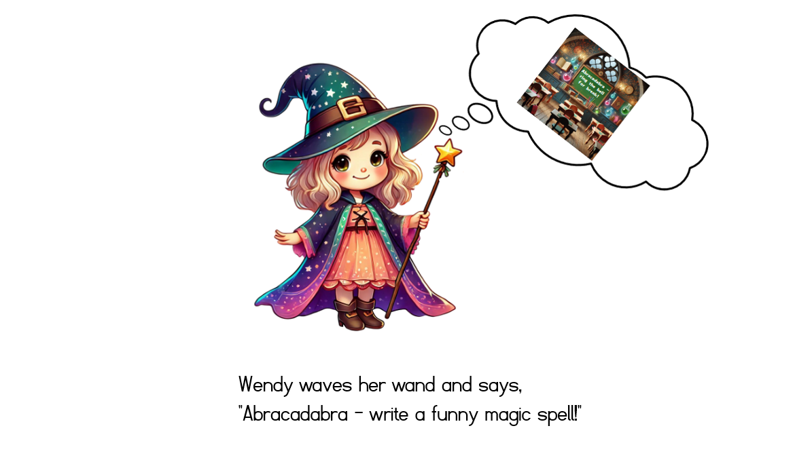

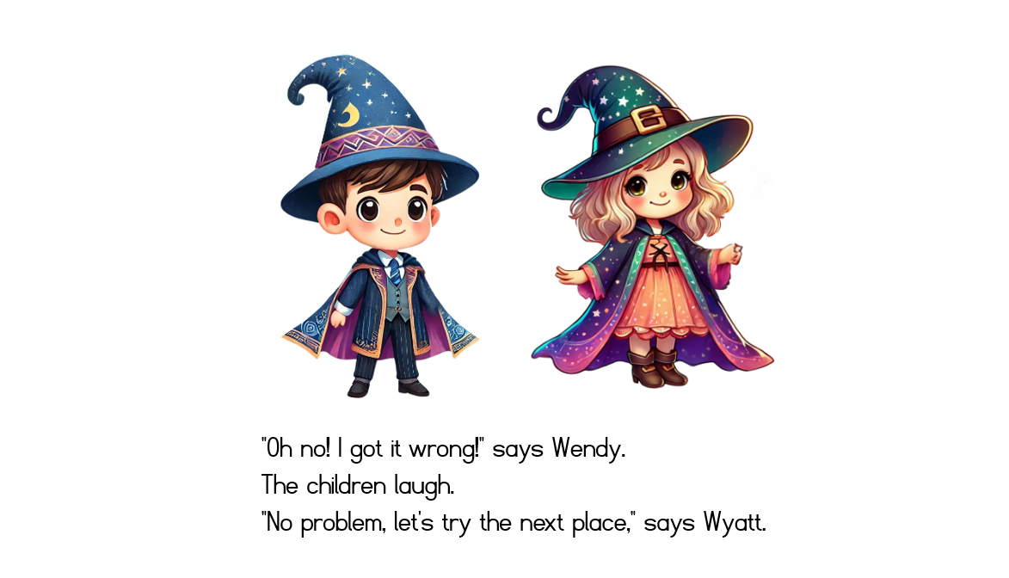
Appendix

Slide 26
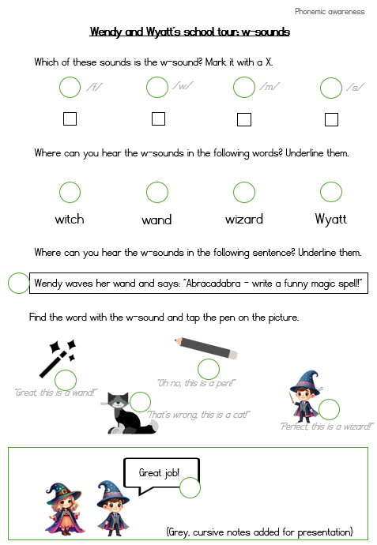

Exercise sheet
= sticker for AnyBookReader

